Slide 1
Digital Portfolio
STUDENT NAME: A.MOHAMED ASHIF
REGISTER NO AND NMID: 2428F0063 and 16C0AF3CF3A1037BD6245C76F70DF640
DEPARTMENT: BSC.COMPUTER SCIENCE(ARTIFICIAL INTELLIGENCE)
COLLEGE: PPG COLLEGE OF ARTS AND SCIENCE / BHARATHIYAR UNIVERSITY

Slide 2
PROJECT TITLE
SIMPLE PORTFOLIO

Slide 3


AGENDA
Problem Statement
Project Overview
End Users
Tools and Technologies
Portfolio design and Layout
Features and Functionality
Results and Screenshots
Conclusion
Github Link
3/21/2024 Annual Review

Slide 4

PROBLEM STATEMENT
Purpose:
In today’s digital world, having a personal online portfolio is essential for showcasing skills and projects.
Students and developers often lack a central place to display their work professionally.
Goal:
Build a responsive and interactive personal portfolio using basic web technologies.

Slide 5

PROJECT OVERVIEW
A single-page website that highlights:
Personal introduction
Technical skills
Academic & personal projects
Contact information
Built entirely using HTML, CSS, and JavaScript

Slide 6

WHO ARE THE END USERS?
Students & Fresh Graduates – for showcasing projects and resumes.
Recruiters/Employers – to quickly evaluate candidate portfolios.
Peers & Mentors – to explore skill development and collaboration opportunities.

Slide 7

TOOLS AND TECHNIQUES
Frontend:
HTML5 – Structure
CSS3 – Styling and Layout
JavaScript – Basic Interactivity
Others:
Visual Studio Code (VS Code)
GitHub (for version control and hosting)

Slide 8
POTFOLIO DESIGN AND LAYOUT
Header Section – Name, Course, Navigation
About Section – Brief intro and education
Skills Section – List of tech skills
Projects Section – Descriptions of projects
Contact Section – Email, GitHub links
Footer – Copyright
8

Slide 9
FEATURES AND FUNCTIONALITY
Responsive layout (desktop/mobile)
Smooth navigation
Organized sections (About, Skills, Projects, Contact)
External links to GitHub and email
Clean UI with modern font and color scheme

Slide 10
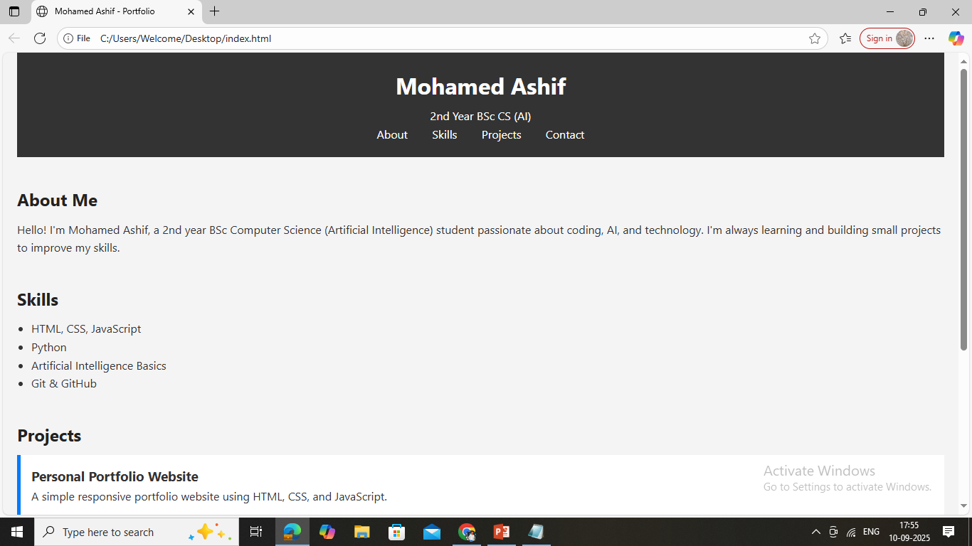

RESULTS AND SCREENSHOTS
3/21/2024 Annual Review
10

Slide 11
CONCLUSION
Built a complete portfolio using basic web technologies.
Gained practical skills in web development, layout design, and project presentation.
The portfolio is ready to be shared with potential employers and academic mentors.
11

